Slide 1
Ecometachip-Mini
A Low-Cost, Eco-Friendly Chemical Identifier Utilizing a Novel Coir-Rubber Dielectric Sensor

Slide 2
Abstract
This paper presents the Eco-MetaChip Mini, a novel, low-cost, and eco-friendly system for the preliminary identification of common liquids based on changes in their relative permittivity (ϵr) using a novel rubber coir material.
Authors : Abhiram B, Aaromal A, Devanarayanan CR, Ivana Anto
Affiliation : School of Engineering, CUSAT (Kerala, India)

Slide 3

The problem
Benchtop FT-IR Spectrometers (current)
Need for low-cost, biodegradable sensing for field analysis

Slide 4
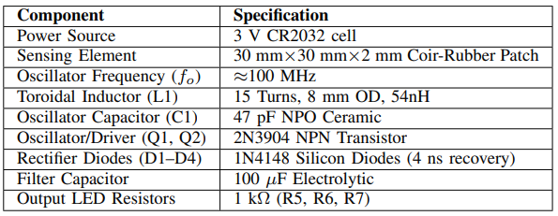
Materials Required

Slide 5
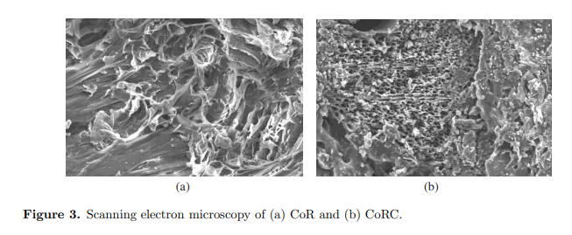

The Novel Material
Coir-Rubber Composite: Porous matrix allows liquid integration

Slide 6
System Architecture
DC source
oscillator
mag. field
coir patch
(modulation)
coupling
Pickup coil
LEDS (Classification)
amplifier
DC
precision rectifier
100 MHz Hartley Oscillator coupled with dielectric resonator

Slide 7

Methodology/Physics (Dielectric Loading)
Liquid permittivity alters capacitance, modulating magnetic field amplitude

Slide 8
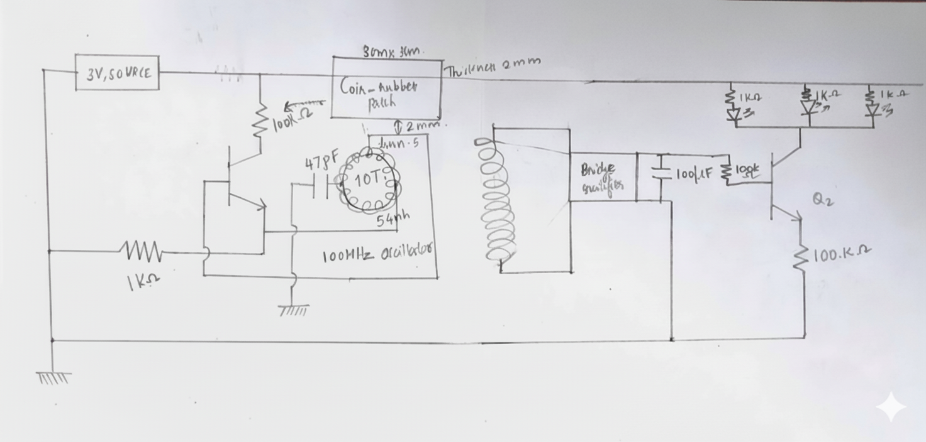
Circuit Implementation
Fast-recovery diodes rectify RF signals to DC voltage

Slide 9
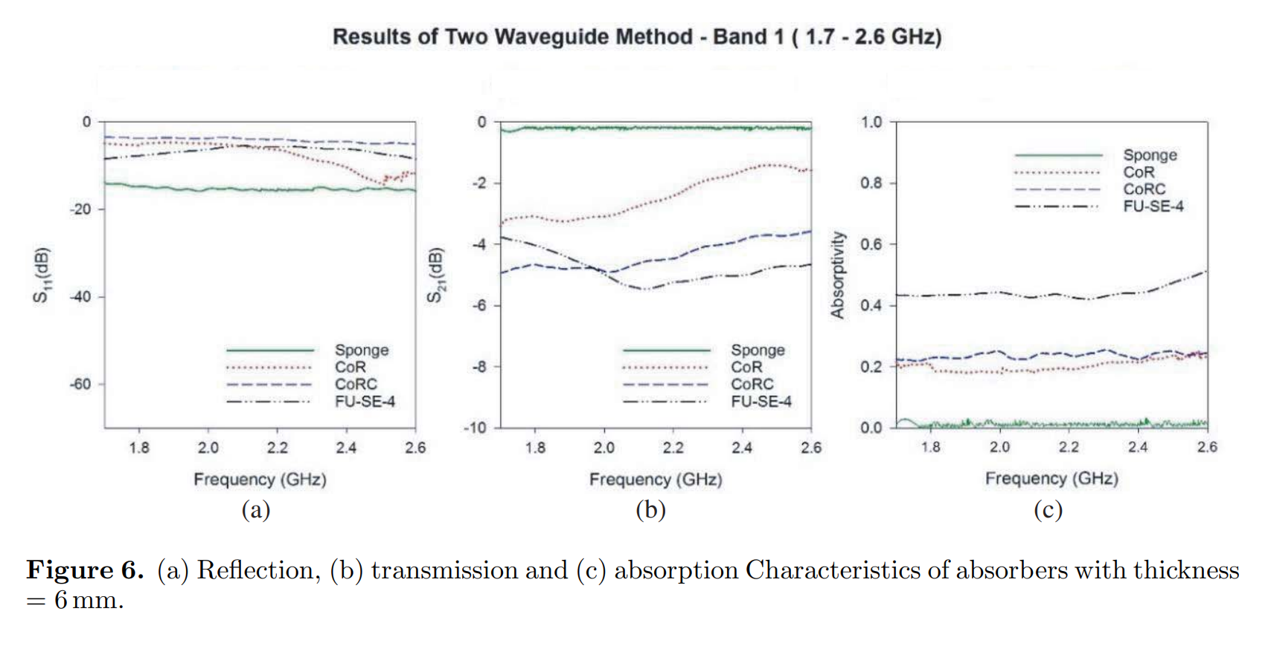
Addressing Signal Loss
Carbon content optimized for coupling, not just absorption

Slide 10
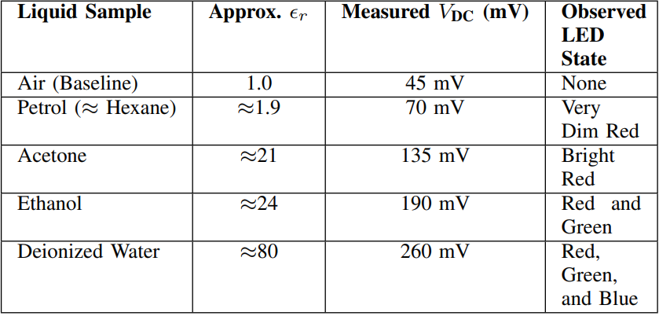
Experimental Results
Higher permittivity liquids generate significantly higher output voltages.

Slide 11
Visual Classification
Three-level LED output based on voltage thresholds.

Slide 12
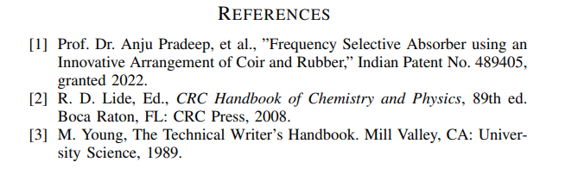
Conclusion & References
Eco-friendly, low-power solution for real-time liquid analysis

